Slide 1

Military Pay
(Updated June 2025)
Disclaimer: The information presented in this lesson does not constitute legal, tax, investment, financial, or other advice. This lesson is intended as an informational resource to assist you in identifying or exploring resources and options for managing your personal financial situation.

Slide 2
Agenda
Managing Military Pay
Types of Military Pay
Military Benefits
Tax Considerations
Common Pay Problems and How to Correct Them
Military Pay

Slide 3
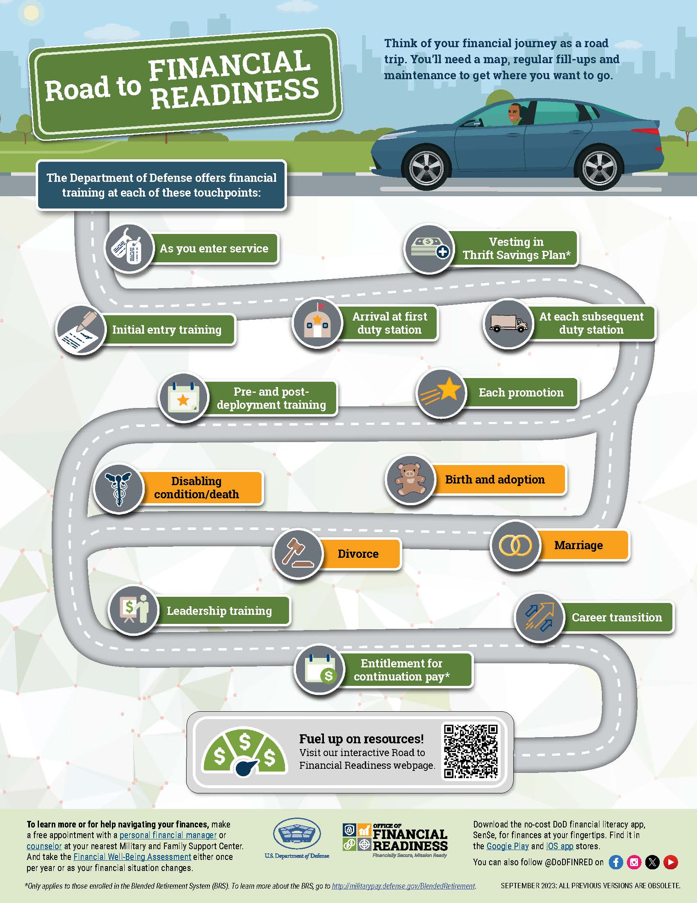
Activity: Pay Management Matters
In the last six months, have you experienced:
Moving or PCS?
Marriage, divorce, or welcoming a new child?
Promotion or job change?
Deployment or temporary orders (TDY)?
Military Pay

Slide 4
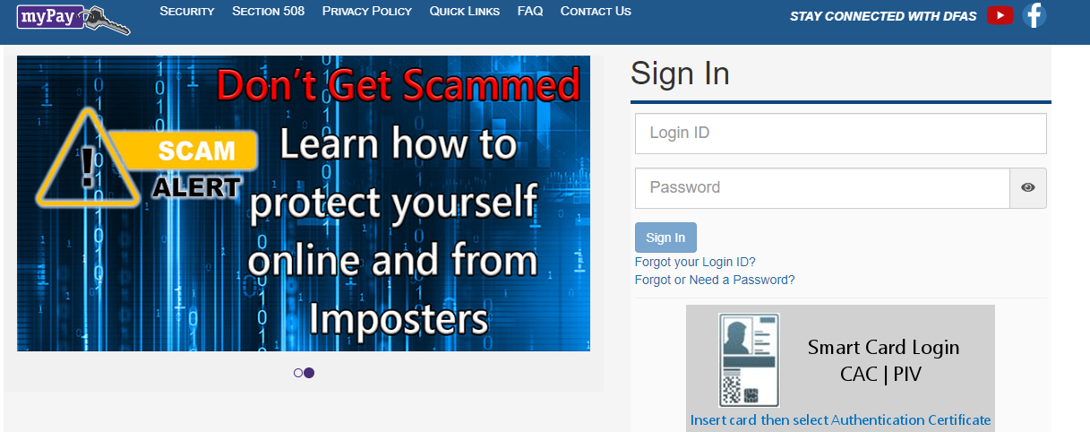
Accessing Your Pay Statement
Army, Air Force, Navy, Marine Corps, Space Force: https://mypay.dfas.mil/
Coast Guard: https://hcm.direct-access.uscg.mil/
Know your entitlements
Understand law and policy
Life circumstances change
Maintain readiness
Stay on track
Military Pay

Slide 5
Pay System Overview
Pay System Tasks:
    Update personal information and access pay statements
    Change tax withholding
    Manage allotments
    TSP management
Direct Deposit System
Pay Frequency
For additional assistance, contact your pay system online or by phone via the information listed below.
DoD - DFAS -
  Online: https://mypay.dfas.mil/ then select “FAQ”
  Phone: 1-888-332-7411, option 5
Coast Guard Pay and Personnel Center – Direct Access
  Online: https://www.dcms.uscg.mil/ppc/pd/da/
  Phone: 1-866-772-8724
  PPC-DG-CustomerCare@uscg.mil
Military Pay

Slide 6
Understanding Your Pay Statement
Includes your full name, last four digits of your Social Security number, pay grade, pay base date, years of service and Expiration Term of Service (ETS).
Personal Information
Entitlements/Deductions/Allotments/Summary
Other figures that make up your monthly compensation, such as pay, allowances, taxes, deductions, garnishments (if any) and allotments.
Tax Summary
The tax summary paid for the period and the year. It shows the number of exemptions you claim for tax withholding.
Pay Data
Includes the specific information used to determine the allowances you are entitled to receive.
Military Pay

Slide 7
Understanding Your Pay Statement (cont.)
Information on your Traditional and Roth TSP contributions plus agency matching and automatic contributions.
Thrift Savings Plan Summary
Includes your beginning leave balance, the leave you have earned from the beginning of the fiscal year (October 1) and the leave you have used, cashed in, or lost due to a result of exceeding the maximum balance.
Leave Summary
Includes notes from your pay system regarding your monthly statement or other information, such as the starting or stopping of allotments or direct deposit, use of leave, garnishments, or general notes regarding pay, allowances, deductions, or other military benefits.
Remarks
Military Pay

Slide 8
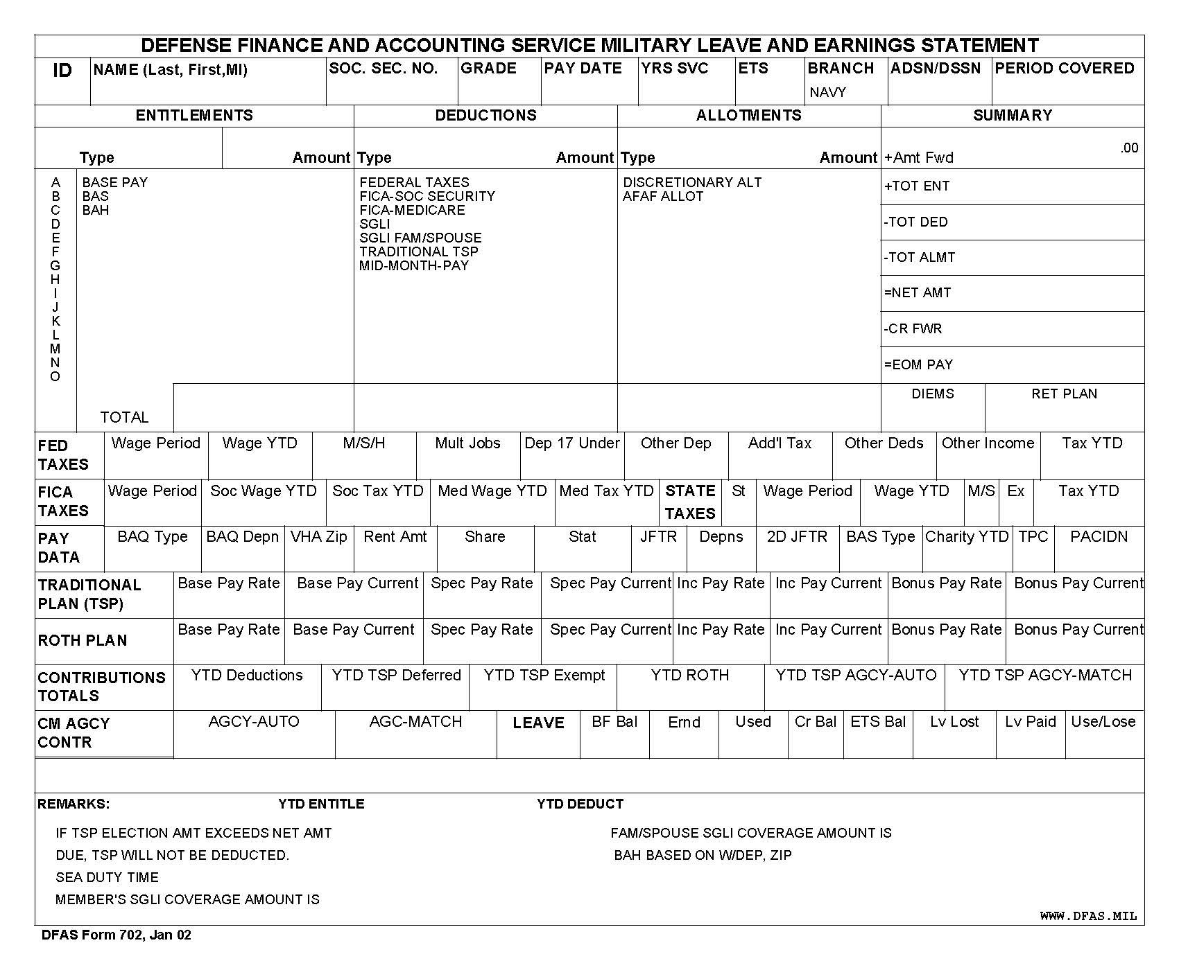
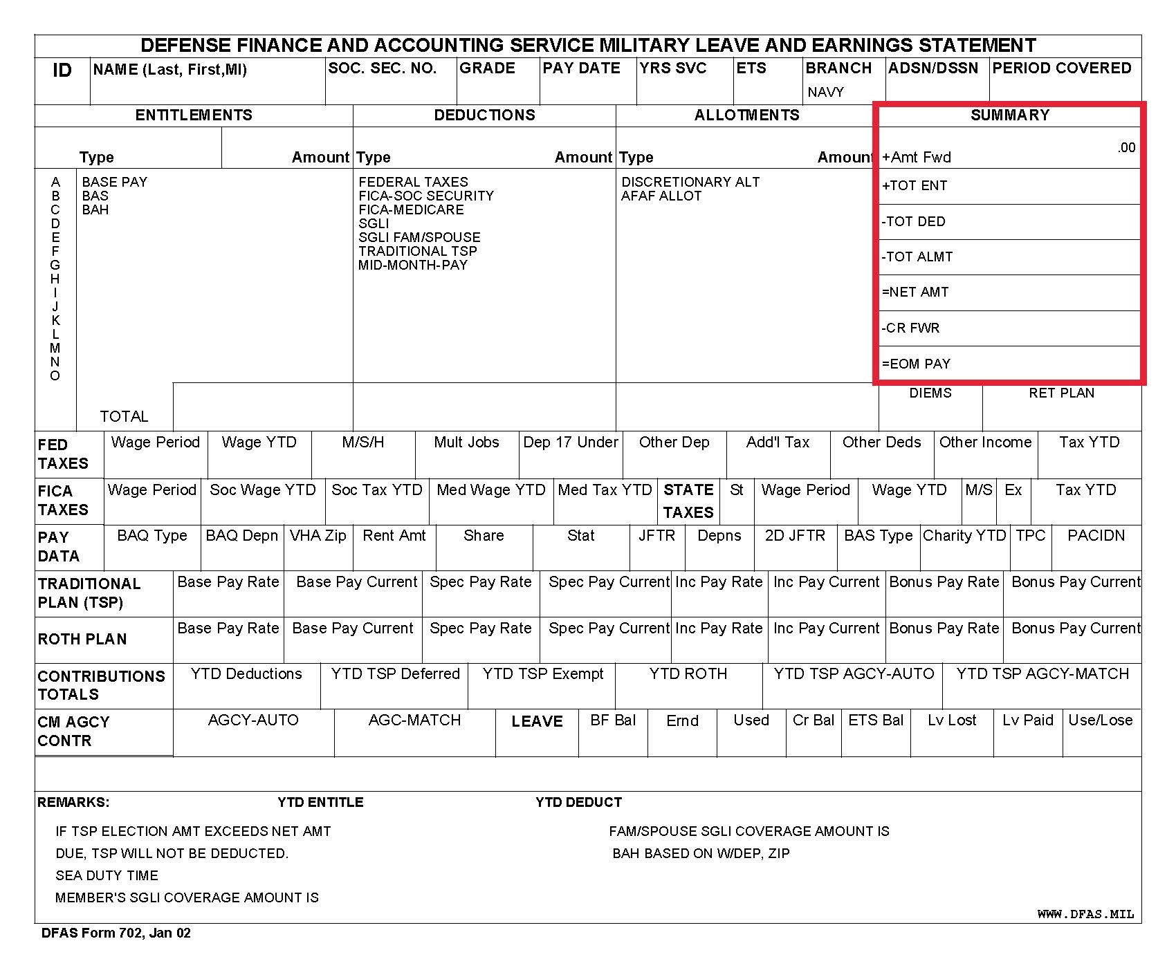
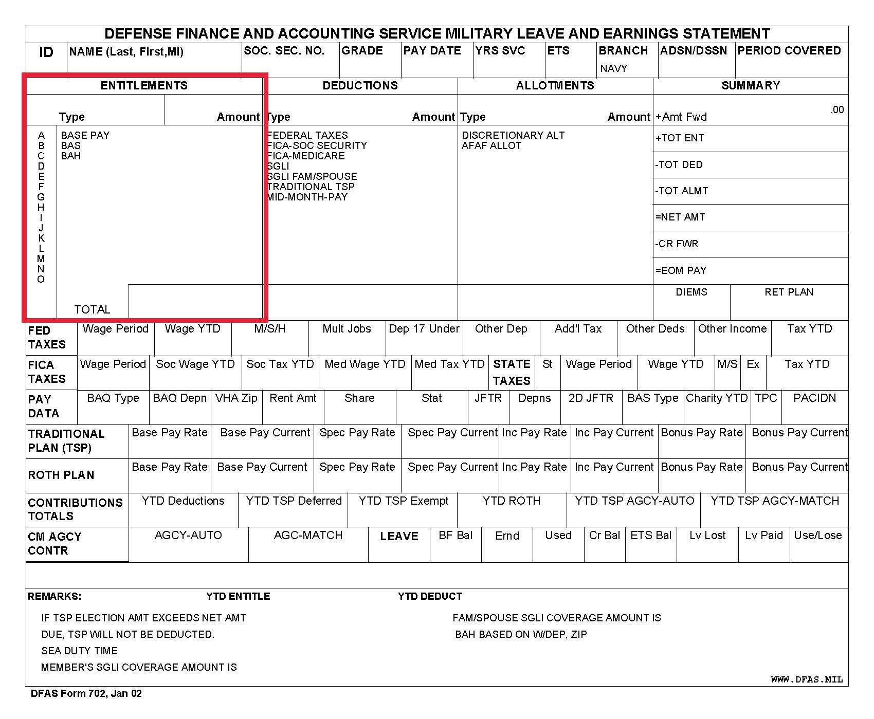
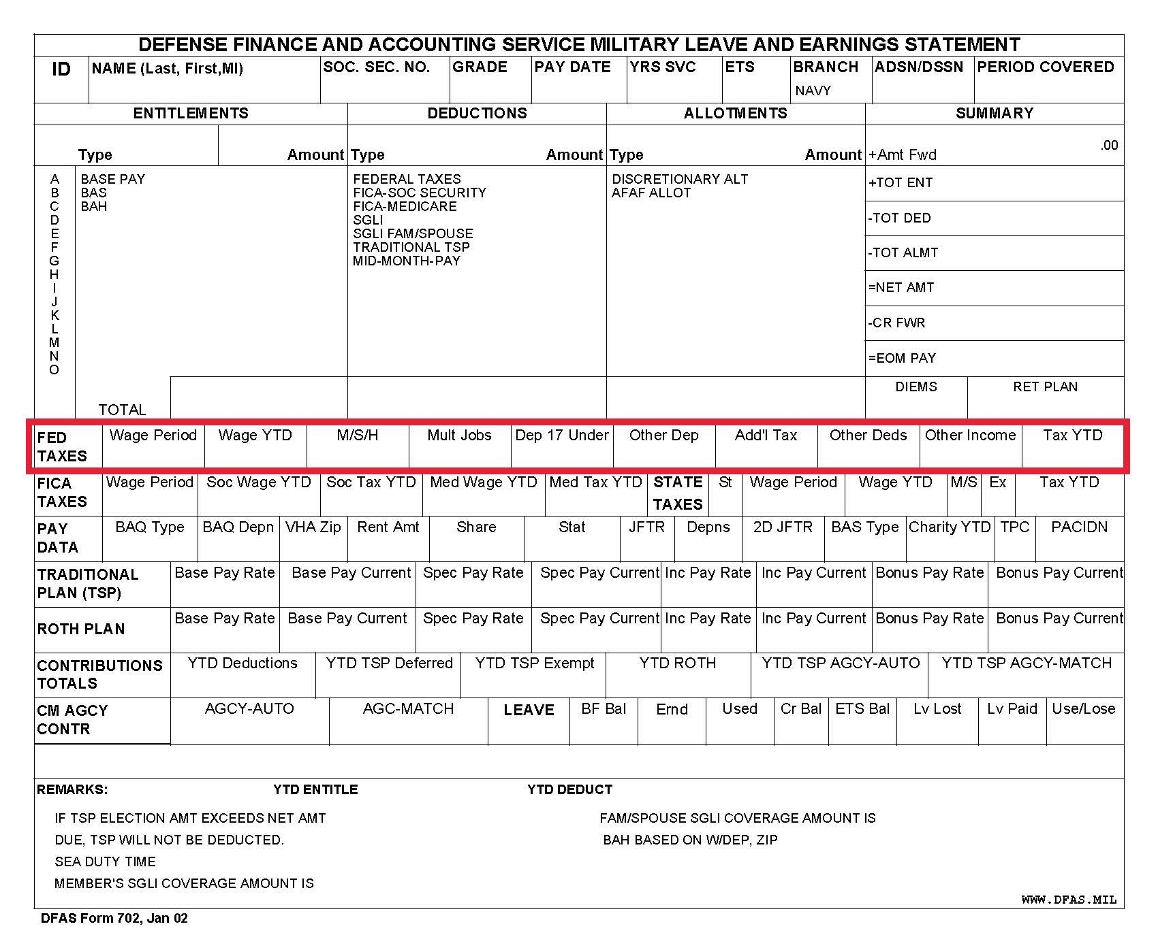
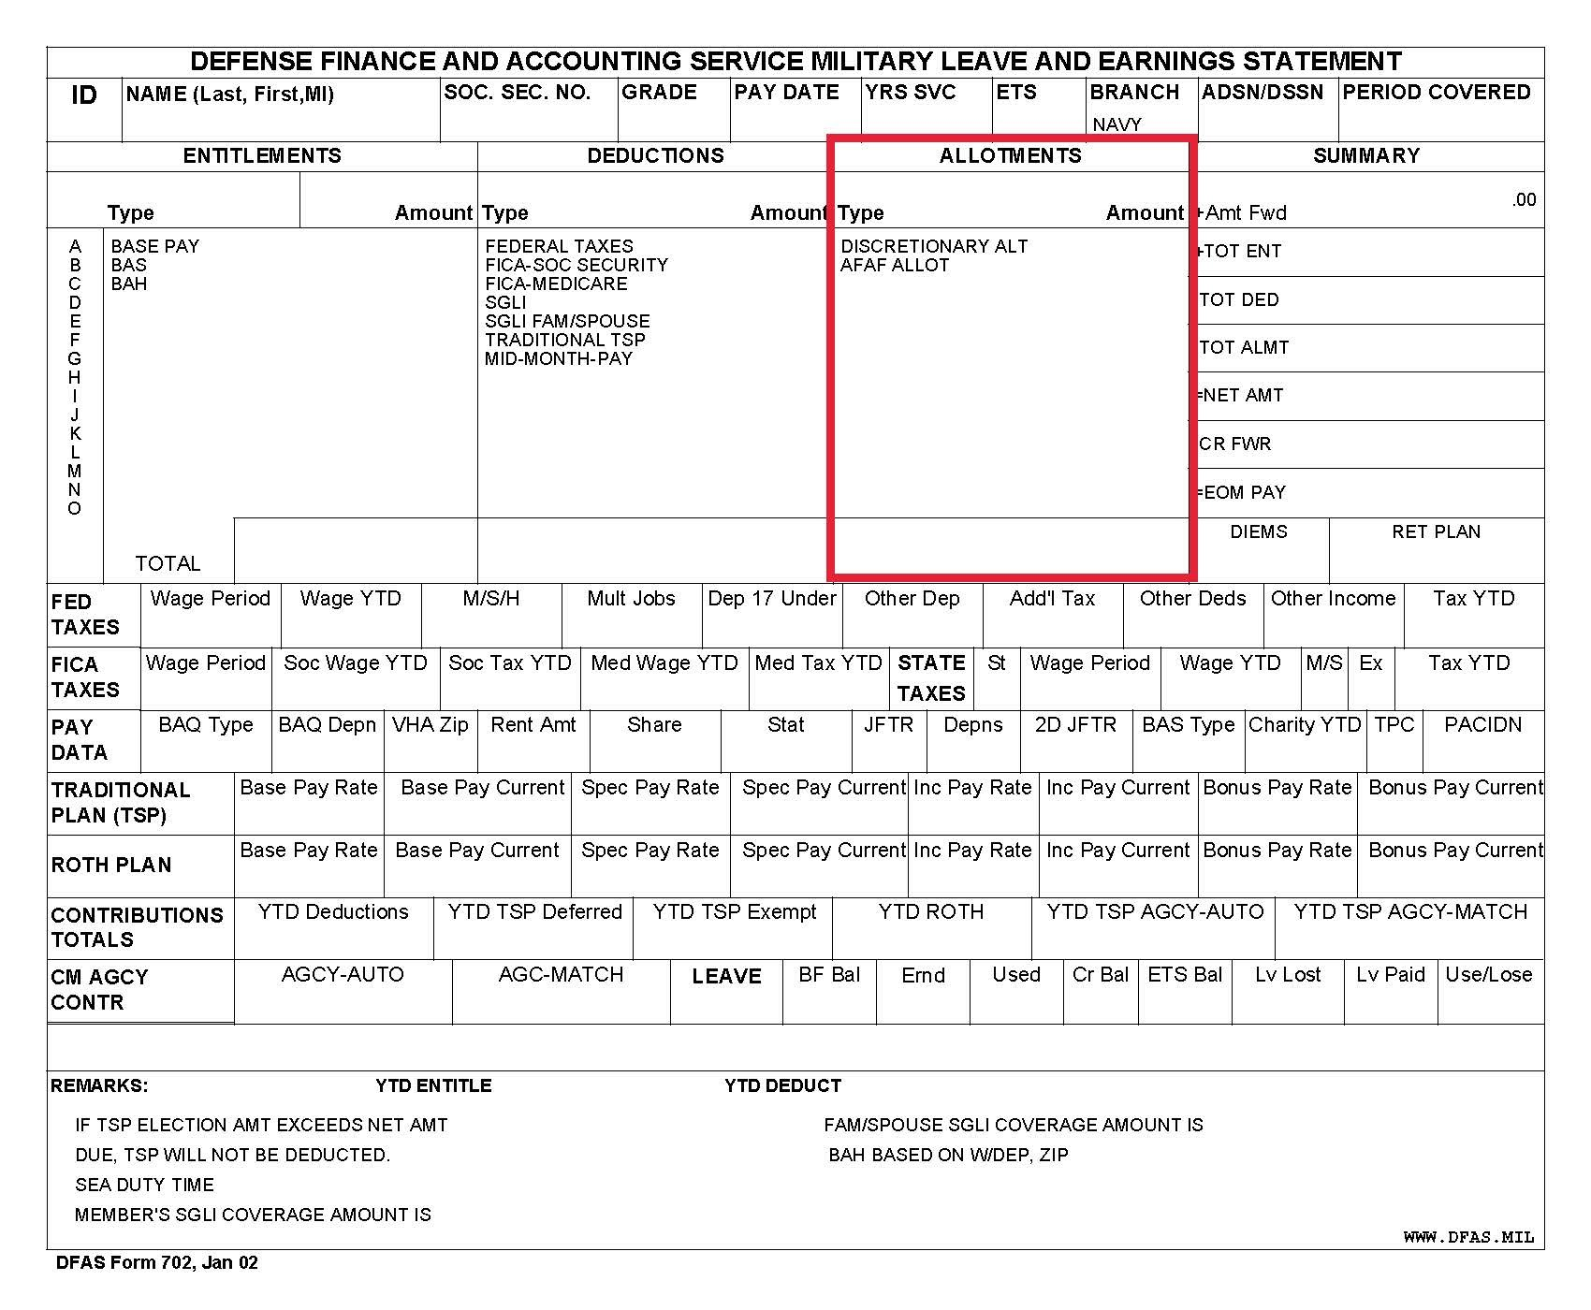
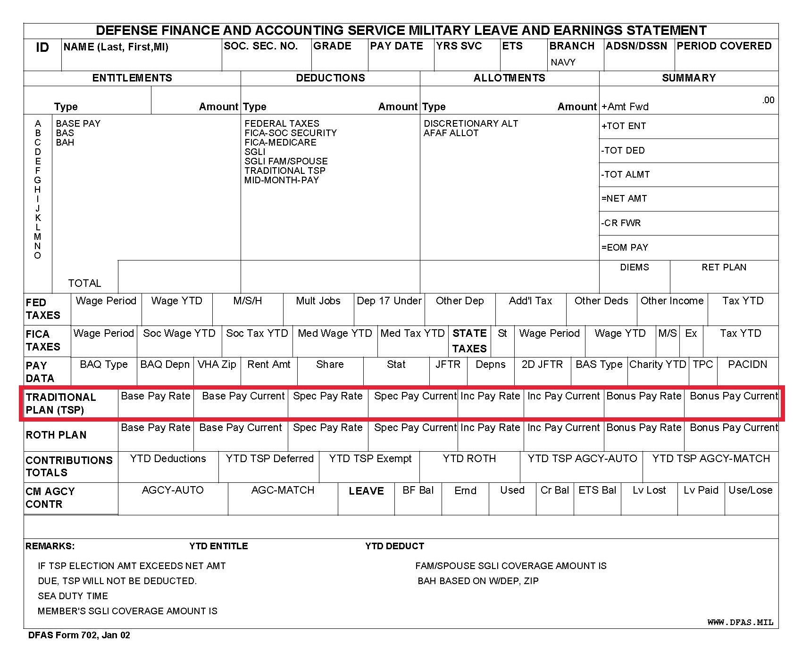
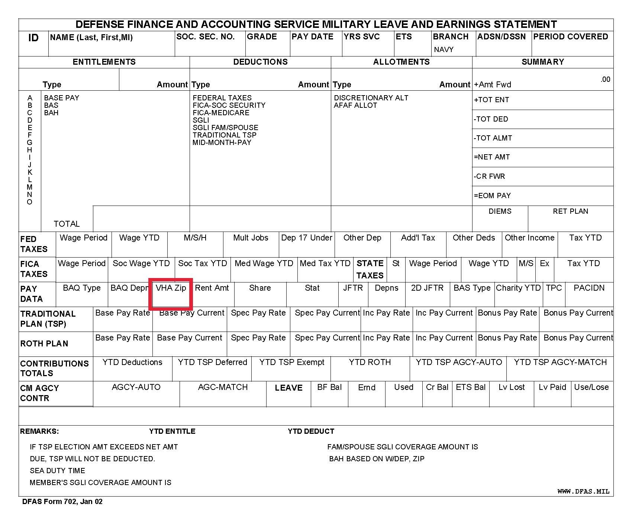
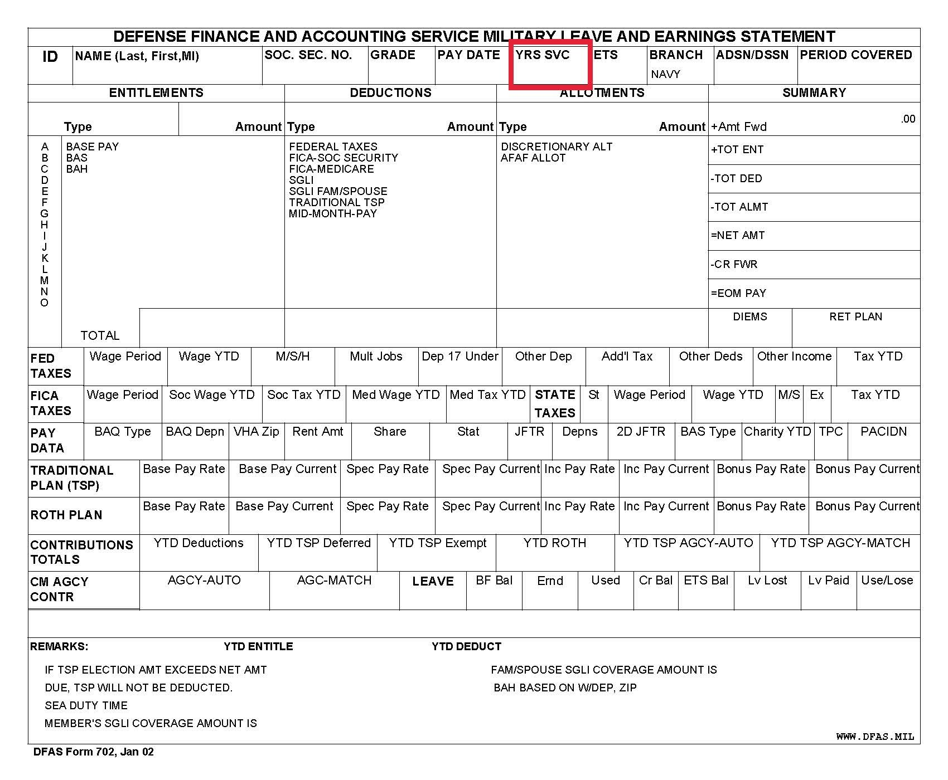
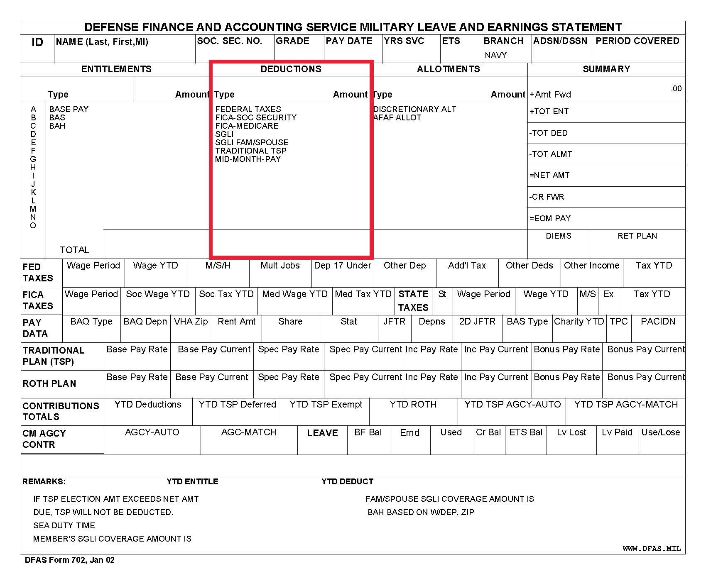
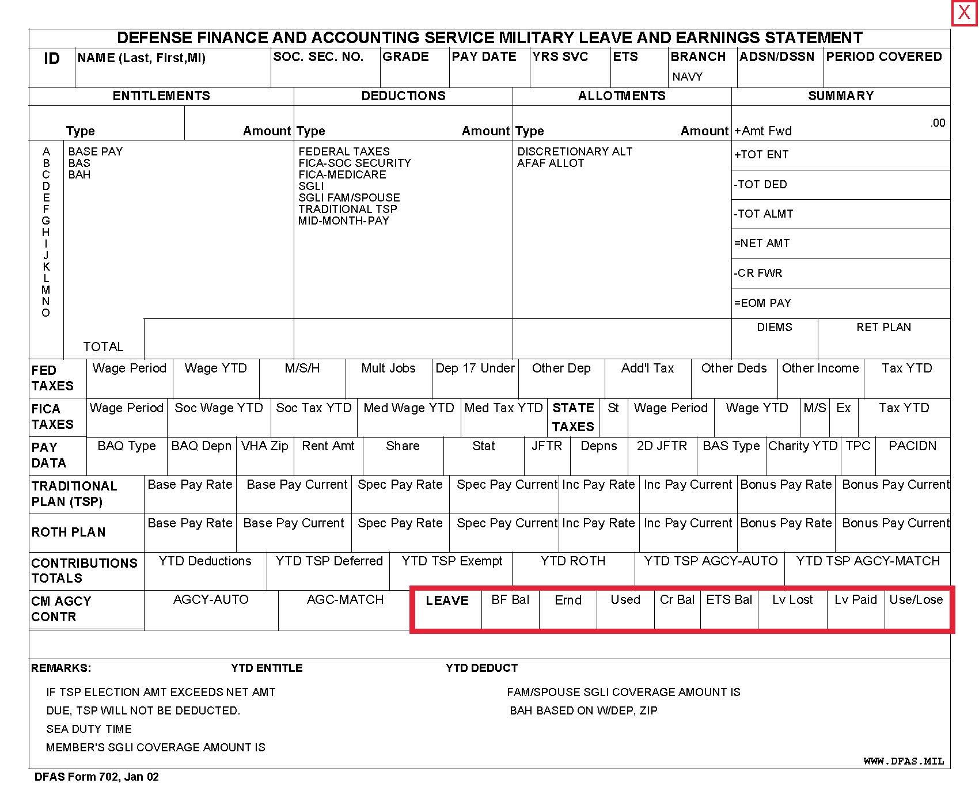
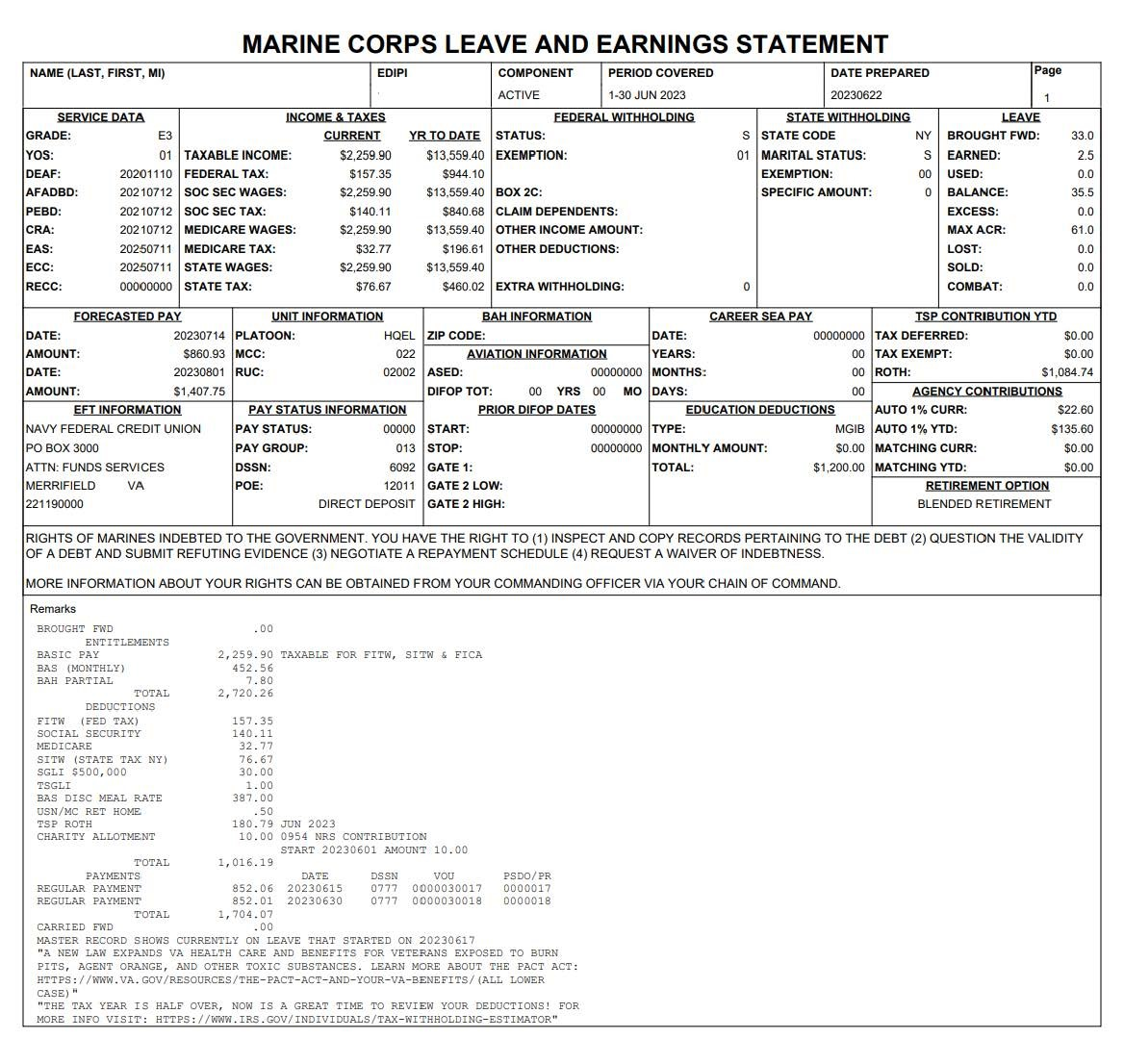
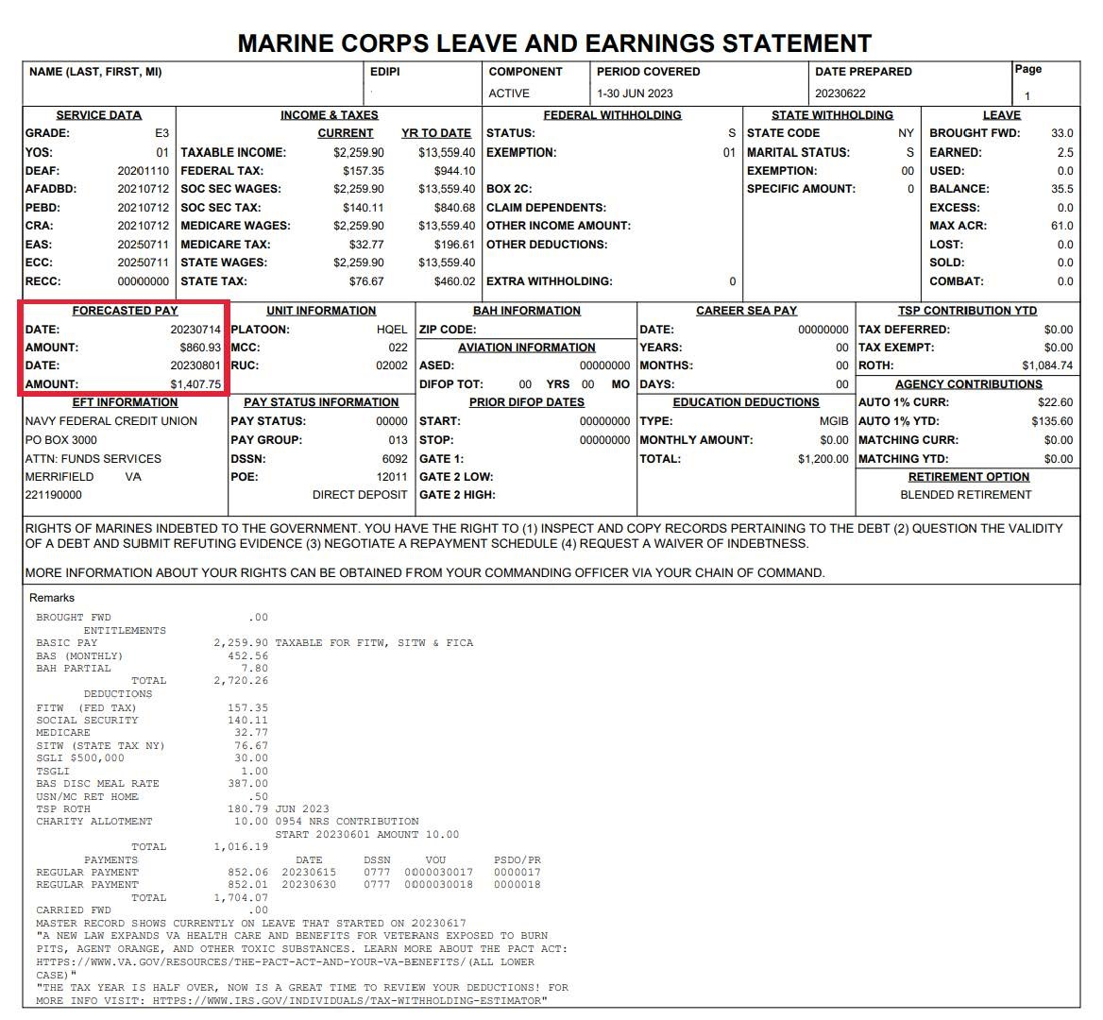
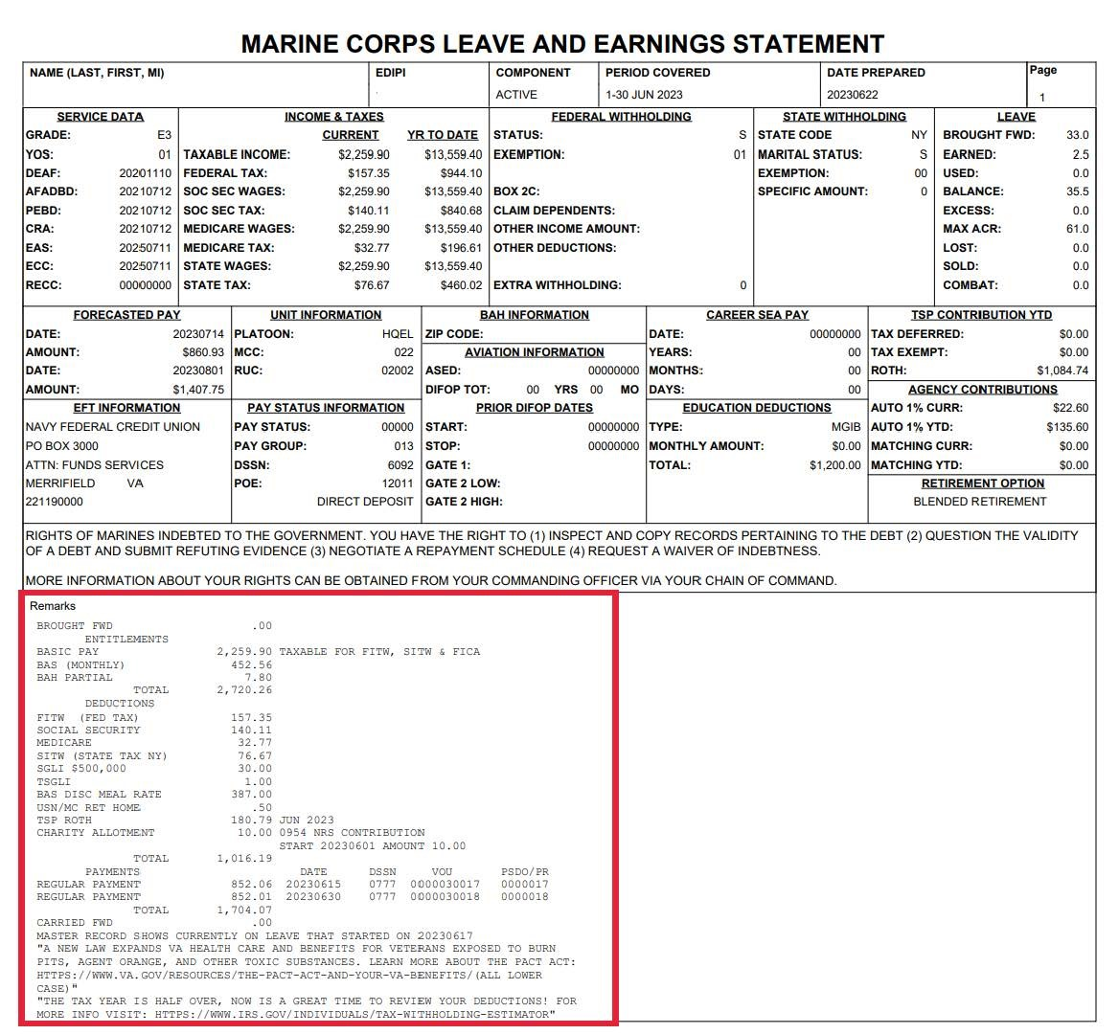
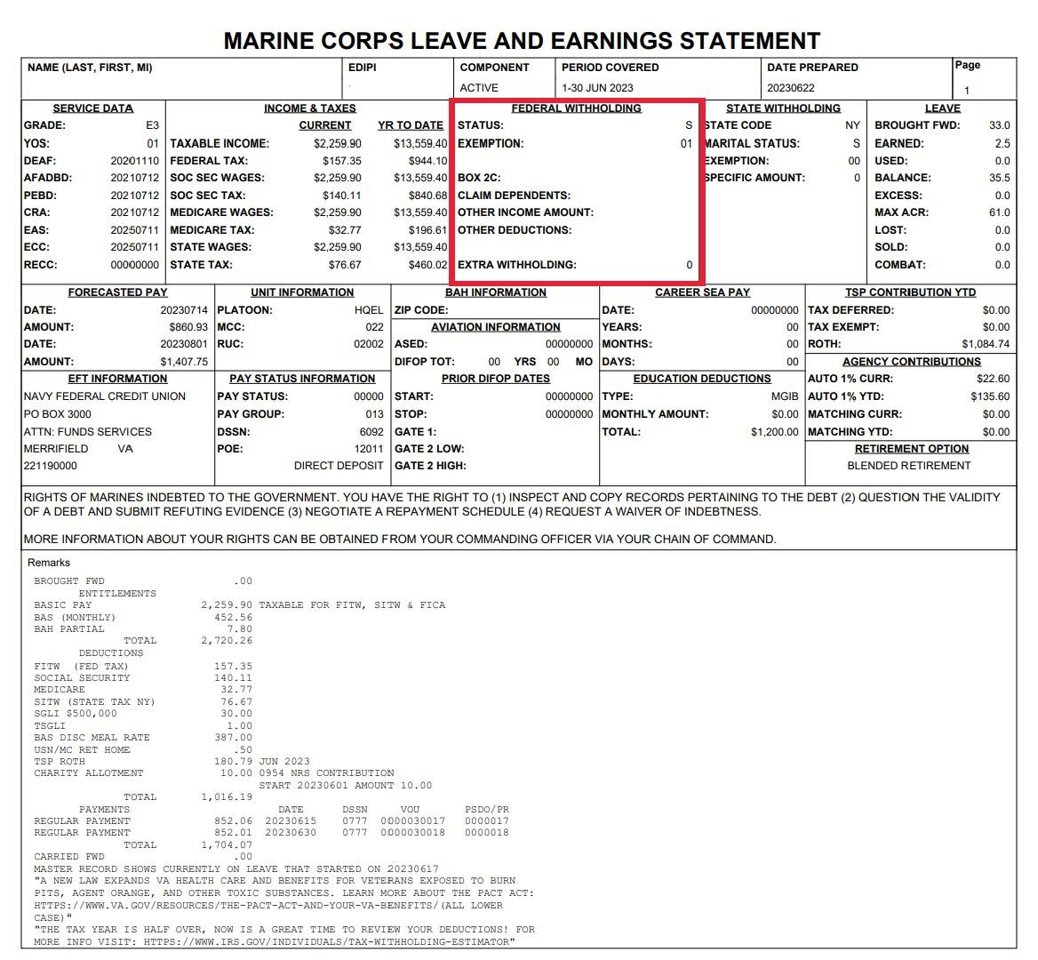
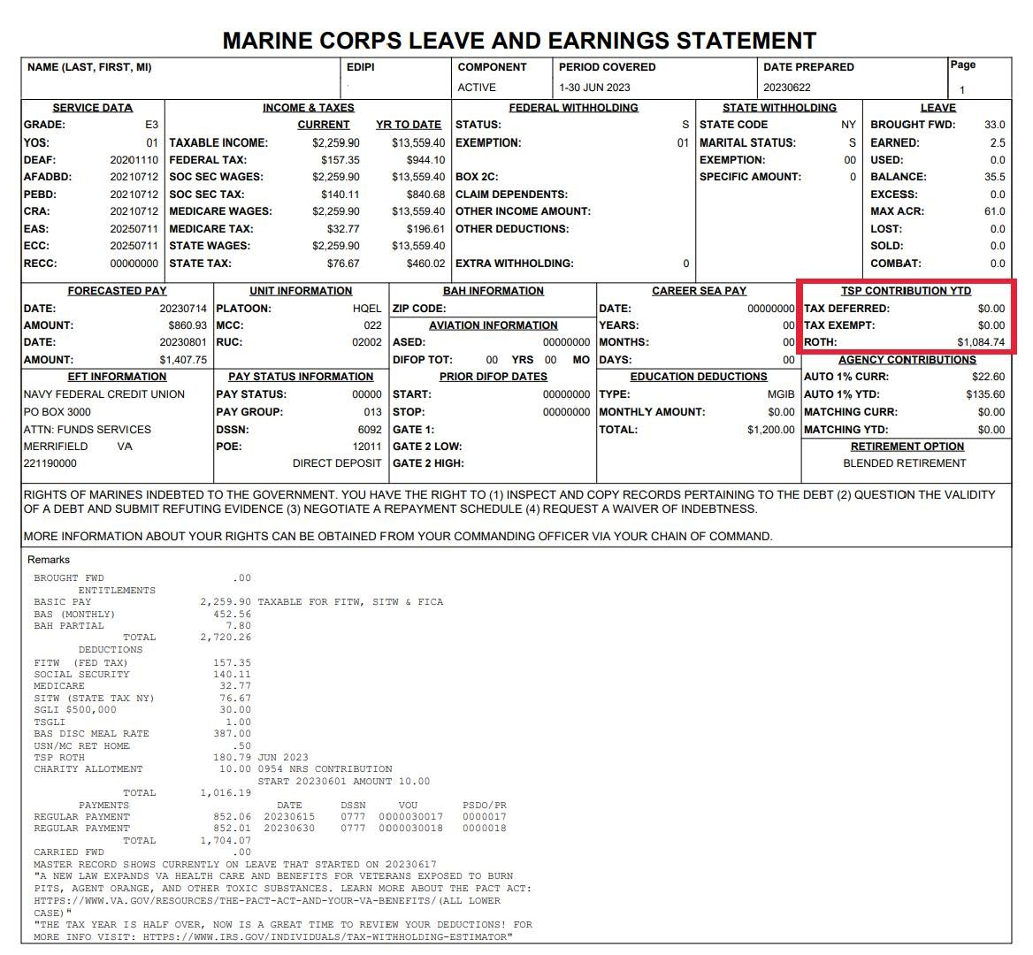
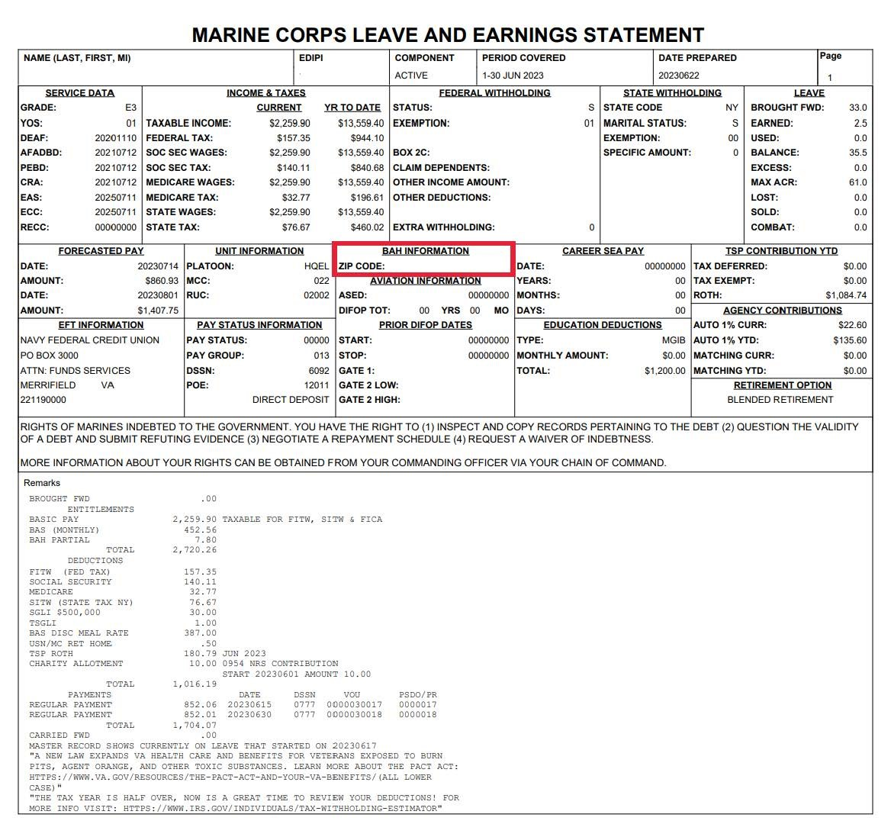
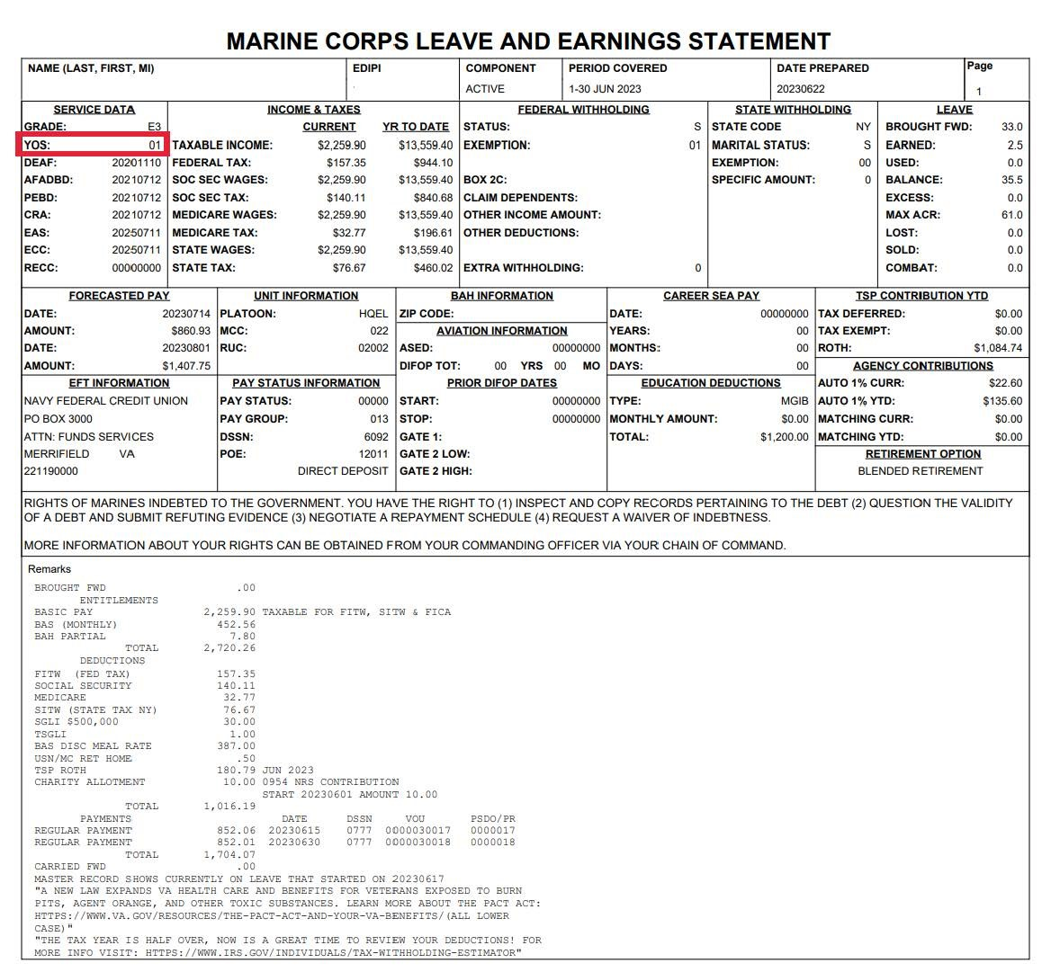
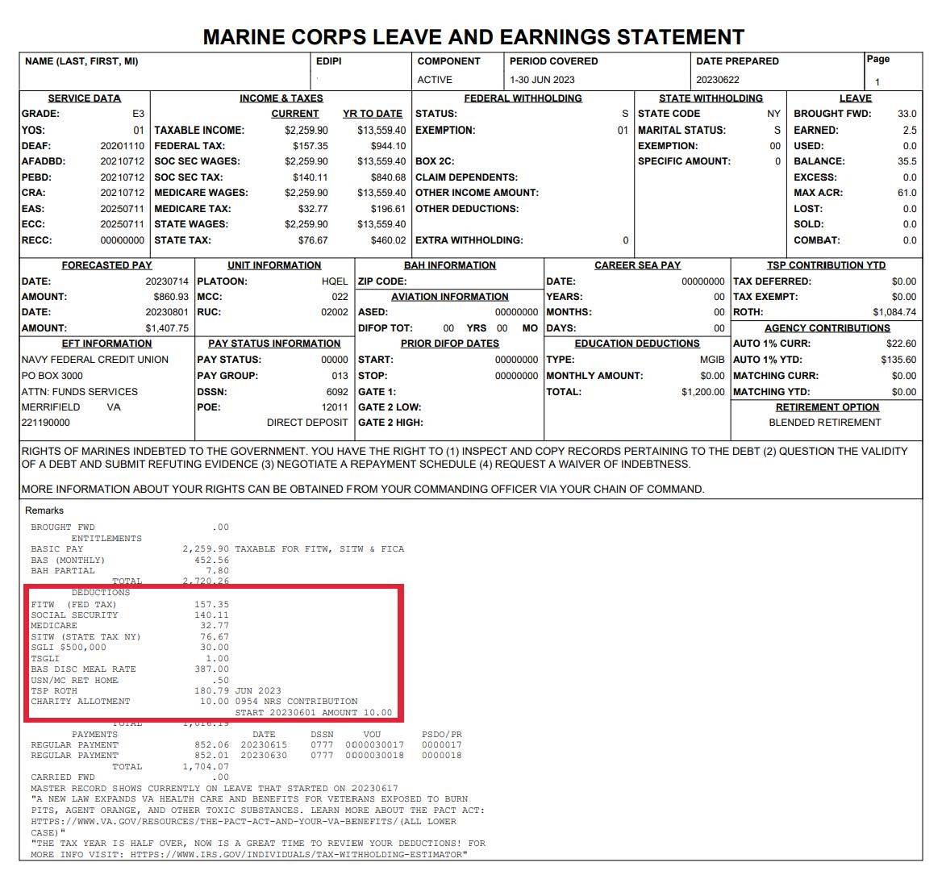
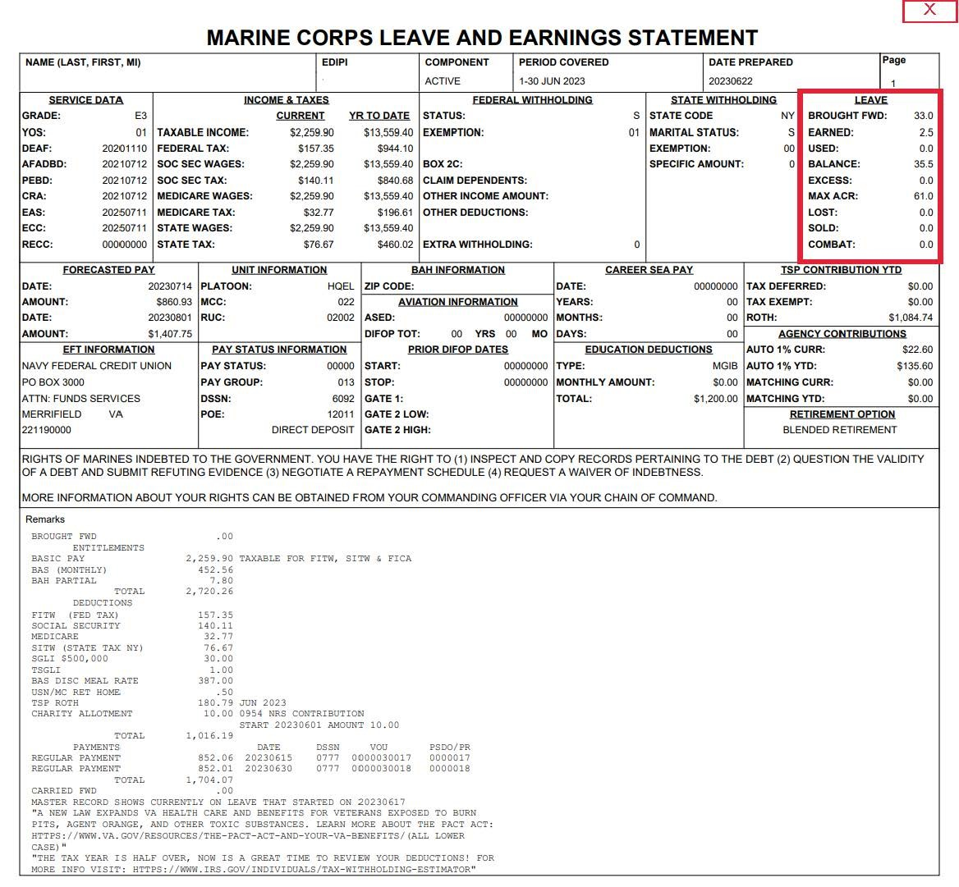
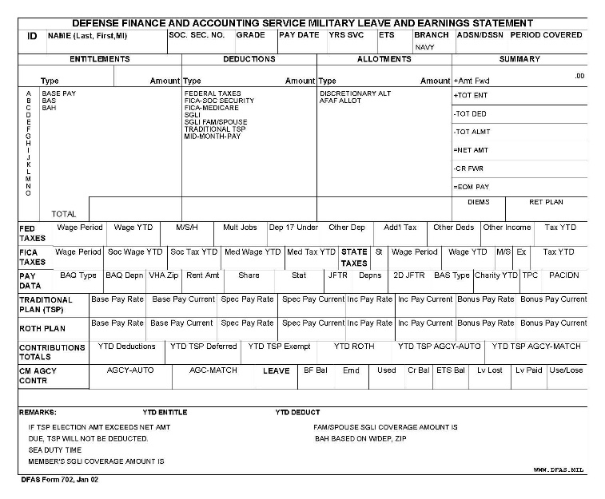
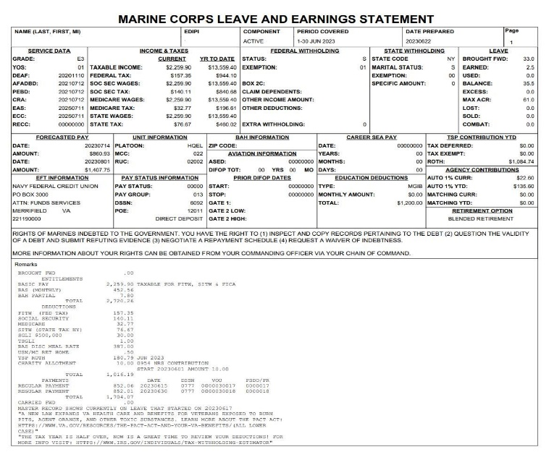
Pay Statement Activity
Shown below are examples of Pay Statements. Try to identify the sections as indicated by your instructor.
Navy / Army / Air Force
Marine Corps
Military Pay

Slide 9
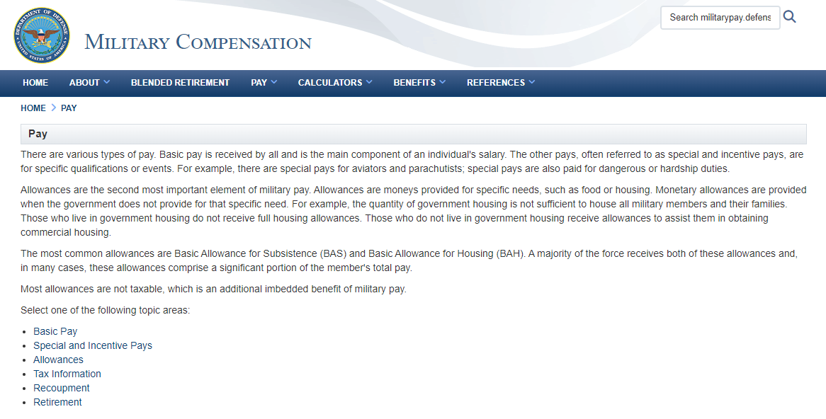
Types of Pay
Basic Pay
  Determined by rank and years of service
Special and Incentive Pay
  Special Recognition
  Skill Incentive
  Critical Skill and Reenlistment
Allowances
  Housing, living, and travel
Website:
www.militarypay.defense.gov
  Military Compensation
  Basic Pay Table
Military Pay

Slide 10
Housing Allowances
Basic Allowance for Housing (BAH) is for those authorized to live off-installation.
Types of BAH
Cost of Living Allowance (COLA)
Overseas Housing Allowance (OHA)
Partial BAH
BAH-DIFF
Military Pay

Slide 11
Allowances
Basic Allowance for Subsistence (BAS)
Designed to offset meal costs
Basic Needs Allowance (BNA)
Depends on household size, income level, and location
Family Separation Allowance (FSA)
Compensation for added expenses due to family separation
Family Supplemental Subsistence Allowance (FSSA)
Depends on household size, income level, and location
Clothing Allowance
Annual allowance for enlisted members and one-time allowance for officers
Military Pay

Slide 12
Moving and Travel Allowances
Travel Allowance for TDY
Travel Allowance for PCS
Mileage and Monetary Allowance in Lieu of Transportation (MALT)
Dislocation Allowance (DLA)
Per diem
Temporary Lodging Expense (TLE)
Temporary Lodging Allowance (TLA)
Military Pay

Slide 13


Advance Pay
Advance Basic Pay
  Up to three months’ pay
Advance BAH
  Up to three months CONUS and 12 months OCONUS
Know the Risks
Military Pay

Slide 14
Allotments
Discretionary
Non-Discretionary
Dependents
Savings Bonds
Relief Loans
Insurance
Government Loans
Mortgage
Charitable Donations
Loans
Privatized Housing Payments
Savings
Child/Spousal Support
Delinquent Taxes
Military Pay

Slide 15
Deductions
Insurance
Garnishments
Other pay withholding
Taxes
Federal and state income taxes
FICA – Social Security and Medicare
SGLI
FSGLI
Dental
Involuntary deduction due to legal action
- Educational assistance
- TSP
- Advance Pay (Basic or BAH)
Military Pay

Slide 16
Military Benefits
SGLI and FSGLI
Thrift Savings Plan (TSP)
Survivor Benefit Plan
Medical and Dental
Education
Leave
Retirement
Military Pay

Slide 17

Tax Considerations
FICA taxes
  Social Security and Medicare
Federal taxes
State taxes
Withholding – federal and state
Volunteer Income Tax Assistance (VITA) program
Military Pay

Slide 18

Common Pay Problems
Overpayments and underpayments
Unexpected repayments
PCS and deployment pay issues
Inaccurate exemptions and/or dependent status
Starting and stopping allotments
Too many allotments
Government credit card misuse
Military Pay

Slide 19
Potential Pay Solutions
Monitor your pay statement
Notify your installation finance office of family status
Monitor allotment start and stop requests
Track your income and expenses
Only use GTCC for authorized expenses
Military Pay

Slide 20
Repayment Options
Extend the repayment period
Make payment arrangements
Submit a waiver of indebtedness
Meet with your finance office or command to request repayment options.
Military Pay

Slide 21
Sources of Help
Websites:
Additional Support:
The Office of Financial Readiness (FINRED)
  https://finred.usalearning.gov/
Volunteer Income Tax Assistance (VITA) Program
  https://www.militaryonesource.mil/benefits/volunteer-income-tax-assistance-program/
MilTax
  https://www.militaryonesource.mil/financial-legal/taxes/miltax-military-tax-services/
CG SUPRT
  CGSUPRT.com
  Personal Financial Managers, Personal Financial Counselors, or Financial Readiness Program Specialists at your local military and family support center
Command/Unit Financial Specialist (USN, USMC, USCG)
Installation legal office
Military aid and relief societies
Military Pay

Slide 22
Conclusion
Managing Military Pay
Types of Military Pay
Military Benefits
Tax Considerations
Common Pay Problems and How to Correct Them
Resources
Military Pay

